Slide 1
Checkstyle Web Coder
Ram Vadlamani

Slide 2
Front-End
Consists of JS, HTML, CSS, and JSON files:
Manifest.json
Browser Action
Content Script files and jQuery
Background file
Web accessible resources

Slide 3
Manifest File
Name: Checkstyle Web Coder
Description: checks the style of code in 3 different websites
Browser action: popup.html and icon.png
Content Scripts:
Matches: contains URL for 3 different websites
JS: JavaScript pages used to extract information from these pages
Background: strophe.js and background.js (files used to connect to server)
Permission: activeTab (focuses on the tab that is active) and storage (used for sending information to web-accessible resource)
Web Accessible Resources: c.ico (pops up when coding text area clicked on) and codestyle.html

Slide 4
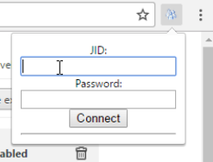
Browser Action
Icon.png : shows up to the right of the address bar
Popup.html/js: form used to sign in to XMPP

Slide 5
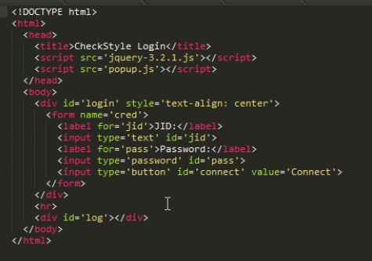
POPUP.HTML
Username for Openfire
Password for Openfire
Changes to ‘Disconnect’ when attempting to connect or successfully connected

Slide 6
Content Scripts
3 websites used for this and each function the same way:
Compilejava, Ideone, and jDoodle
For each website, grab the code written in the textbox and send it to the background file
Messages are sent to the background file, every time the tab is refreshed and every time the code area is clicked on or on keypress.
C.ico image appears at the bottom of the textbox when the textbox is clicked on

Slide 7
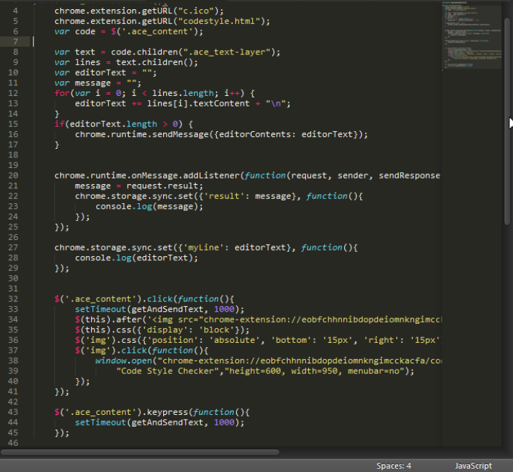
Content Scripts Code
Add the code the user types into the variable “textEditor”
Send the code written to the background file if the code length is greater then 0
Listen for message from background file and store the message
Store the “textEditor” code
Call this method with any click on the code textbox or with any key press
“C” image appears when textbox with code is clicked on and if the “C” is clicked on a new window is opened

Slide 8
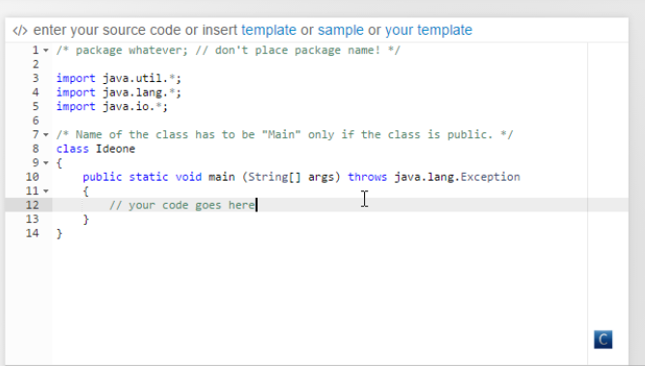
Content Scripts cont.
Pops up when code area clicked on

Slide 9
CODESTYLE.HTML
Web accessible resource that pops up when c.ico is clicked.
Has two textboxes:
One that has the code
Other that shows check style errors in the code
Gets the code from chrome.storage used in the content scripts
Gets the check style errors from the background file via chrome.storage used in content scripts.

Slide 10
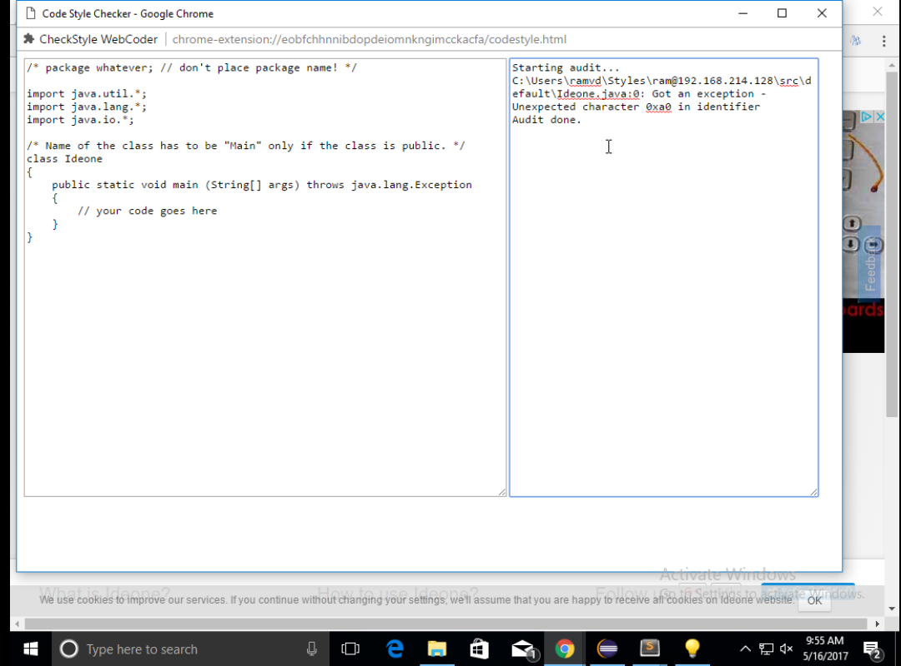
CODESTYLE.HTML cont
HTML page appears when “c” image clicked on

Slide 11
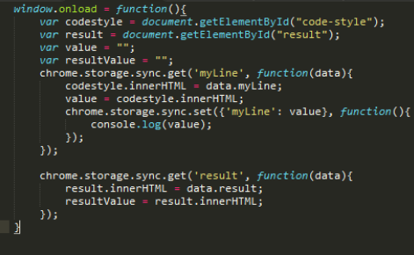
CODESTYLE.JS
Gets the “textEditor” stored value and writes it in the textarea with the id “codestyle”
Gets the “result” stored value and writes it in the textarea with the id “result”

Slide 12
Background files
Two background files are used to connect to the server:
Strophe.js: JavaScript library for writing XMPP clients
Background.js: uses Strophe.js to connect to the server
Background.js file receives the code from the content scripts and creates a JSON object that contains the code and the client’s username
Uses strophe.builder to send the message to the server
Receives the message back from the server as a JSON object and sends the check style errors back to the content scripts

Slide 13
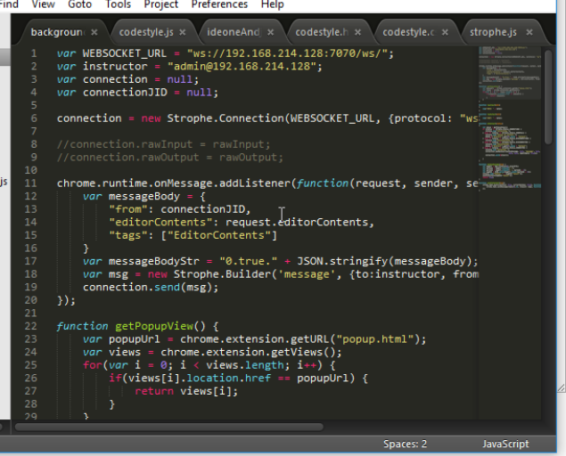
Sending Message To Server
Sets up the websocket URL and the username of the instructor (login that gets the code message and calls the checkstyle on the code)
Listens to the message from the content scripts, makes the the into JSON objects, and sends it to the MessageBus
Get the “from” JSON object looking for the username from popup.html

Slide 14
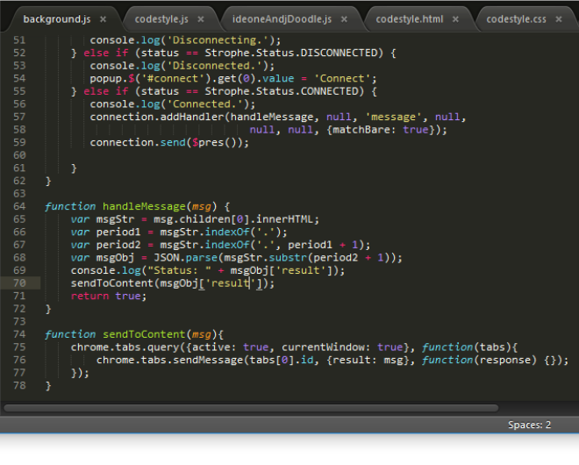
Receiving Message From Server
Parses the data received from the back end and sends it to sendToContent
Sends the message to the content scripts

Slide 15

XMPP
Extensible Messaging and Presence Protocol
Communications protocol for message-oriented middleware

Slide 16
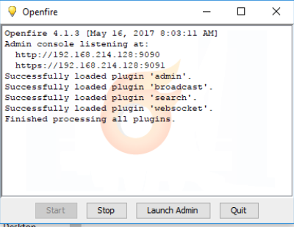
Openfire
An instant-messaging and groupchat server that uses the XMPP server

Slide 17
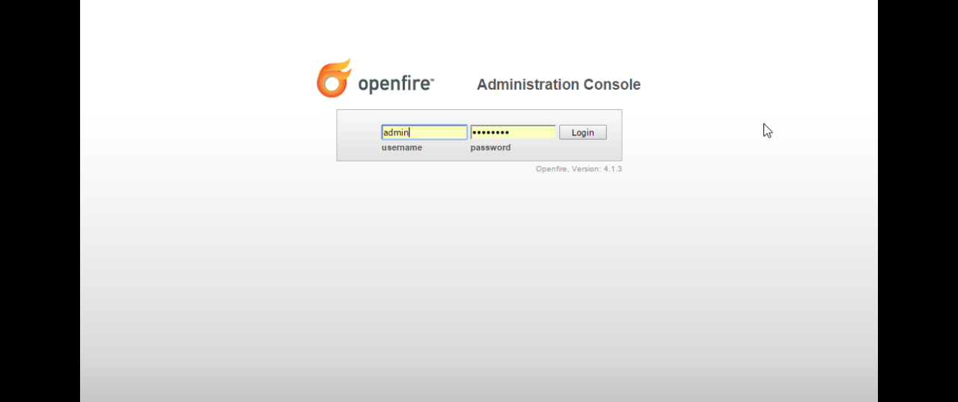
Openfire cont

Slide 18
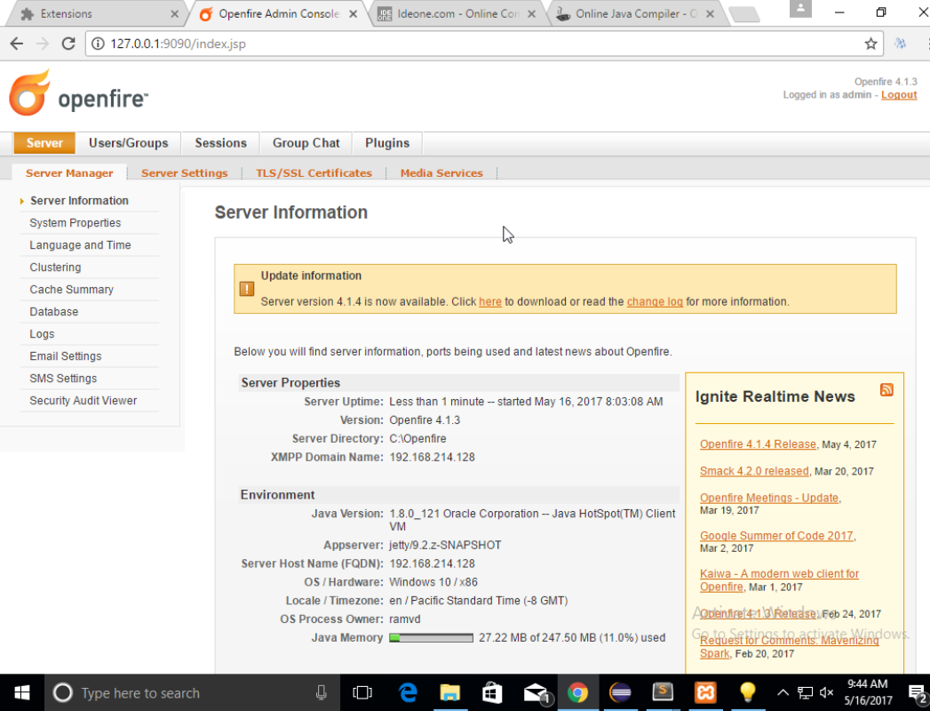
Openfire Admin Page
“username”@ServerHostName

Slide 19
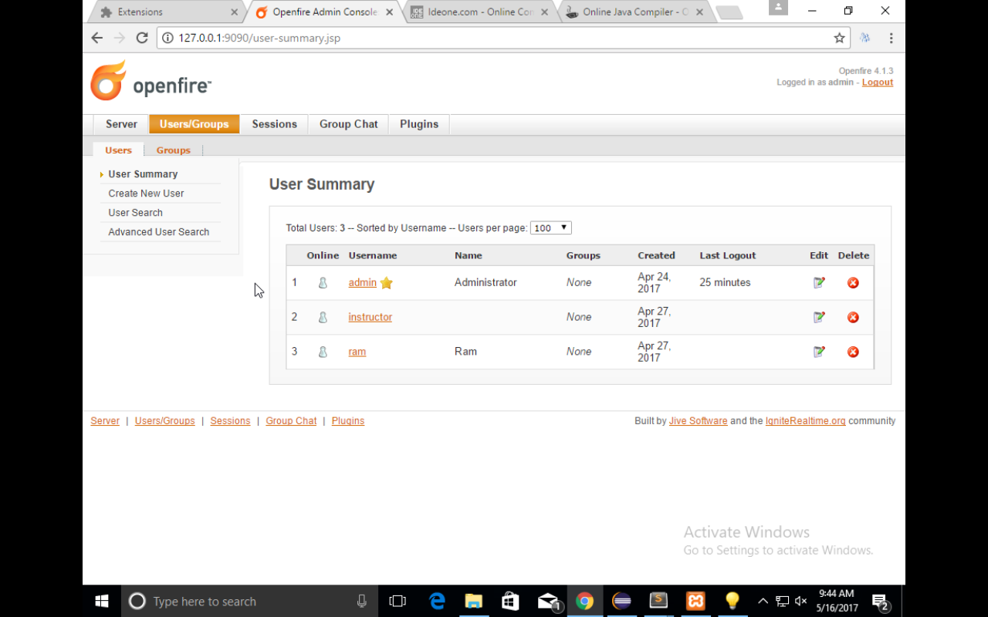
Openfire cont
Multiple accounts created for the purposes of communication

Slide 20
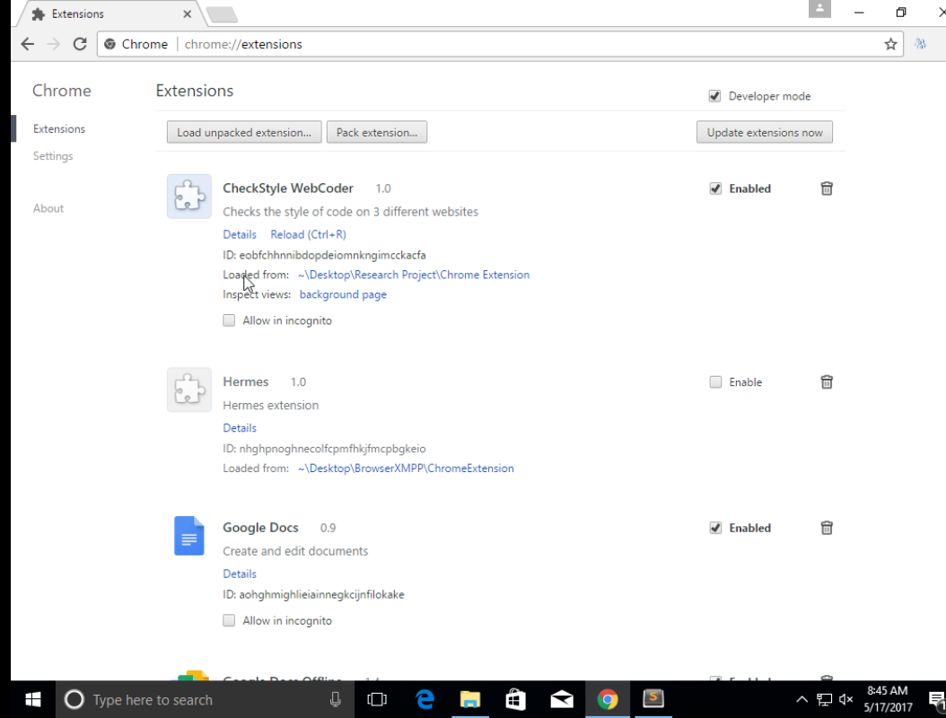
Testing the Chrome Extension
Check developer mode to test Chrome extensions
Click on this button and then the folder which contains the Chrome Extension code to first unpack your extension
Enable the Chrome extension to test it out and reload after any changes made
Allows to check any status from the background (such as connections, and messages from back end)

Slide 21
Back-End
Contains the MessageBus and MessageBus clients
The MessageBus listens for the messages sent to it from the background file in the front end
It parses this JSON object and sends the information to any clients interested (have the tag “EditorContents”)

Slide 22
Checkstyle Web Coder
Client program that listens to the MessageBus
Stores the information based on the class name of the code, package names, and the users’ name in the Styles folder
Ex: username: ram@localhost, package name: none and classname:HelloWorld → Styles/ram@localhost/src/default/HelloWorld
“Default” folder created when no package name given in code

Slide 23
Checkstyle Runner
This is part of the checkstyle web coder program. It receives the file with the code inside and runs the checkstyle program on it to get back any code style messages.
The configuration file it uses is downloaded from Professor Dewan’s Computer Science 401 website.
This message is sent back to the MessageBus as a JSON object, which sends it back to the front end

Slide 24
The End

